Slide 1
Data Processing Performance evaluation
Ph.D. Dang Thien Binh
IT Faculty, Da Nang University of Science and Technology

Slide 2
Regression / classification models
“Supervised” learning
Predictive modeling
A model is a specification of mathematical/probabilistic relationships that exist between different variables
The goal is usually to use existing data to develop models that we can use to predict outcomes for new data, such as
Predicting whether an email message is spam or not
Predicting whether a credit card transaction is fraudulent
Predicting which advertisement a shopper is most likely to click on
Predicting which football team is going to win the Super Bowl
Predicting stock price of a given company
Predicting number of buyers of a certain product
Predicting user ratings of a new movie
Predicting the grade of a disease
Nominal
(categorical with
No particular order)
Continuous / ordinal

Slide 3
Feature extraction and selection
Feature: variables / predictors in the model
In some cases are given
Other cases may need to be extracted or transformed
e.g. to predict if an email is spam, possible features include:
Contain the word “Viagra”?
Number of times the word “prize” appear?
Domain of the sender?
Boolean
Real value
Nominal

Slide 4
Feature extraction and selection
Type of features may limit model choices
Boolean and real valued features can usually be used directly
Nominal features may need to be recoded
Irrelevant features may need to be removed
E.g. frequency of letter “d” in the email
Sample ID | Color
1 | Green
2 | Red
3 | Blue
4 | Green
Sample ID | Red | Green | Blue
1 | 0 | 1 | 0
2 | 1 | 0 | 0
3 | 0 | 0 | 1
4 | 0 | 1 | 0

Slide 5
Performance evaluation
How predictive is the model we learned?
For regression, usually R² or MSE
For classification, many options (discuss later today)
Accuracy can be used, with caution
Performance on the training data (data used to build models) is not a good indicator of performance on future data
Q: Why?
A: Because new data will probably not be exactly the same as the training data!
Overfitting – fitting the training data too precisely - usually leads to poor results on new data
Underfitting – model does not fit training data well

Slide 6



Performance evaluation
MSE (Mean Squared Error) represents the difference between the original and predicted values extracted by squared the average difference over the data set.
R-squared (Coefficient of determination) represents the coefficient of how well the values fit compared to the original values. The value from 0 to 1 interpreted as percentages. The higher the value is, the better the model is.

Slide 7
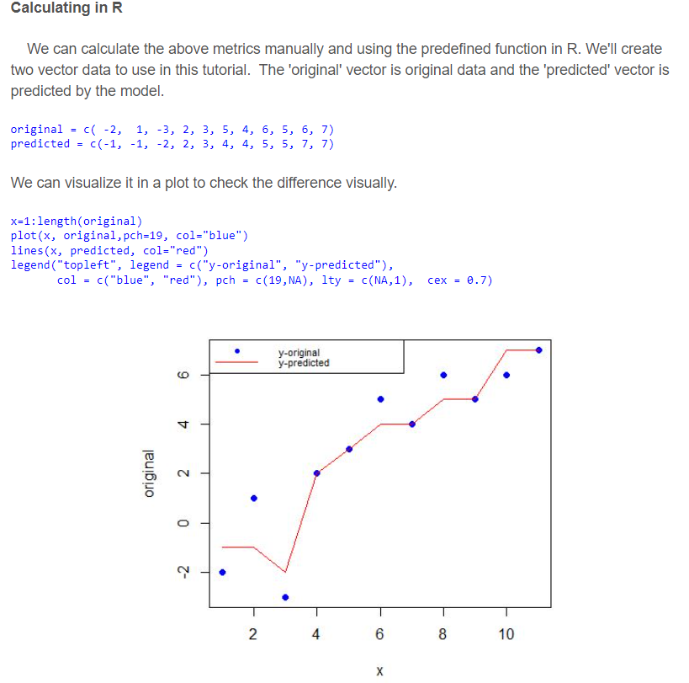

Slide 8
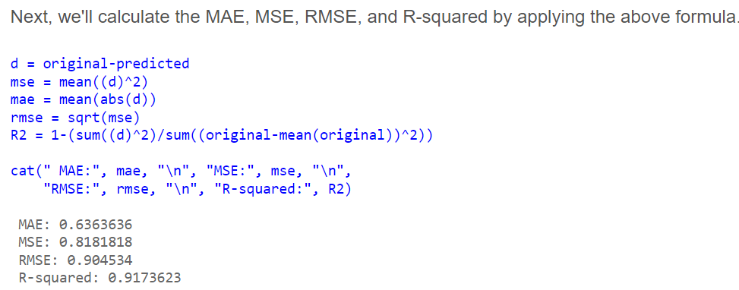
Performance evaluation

Slide 9
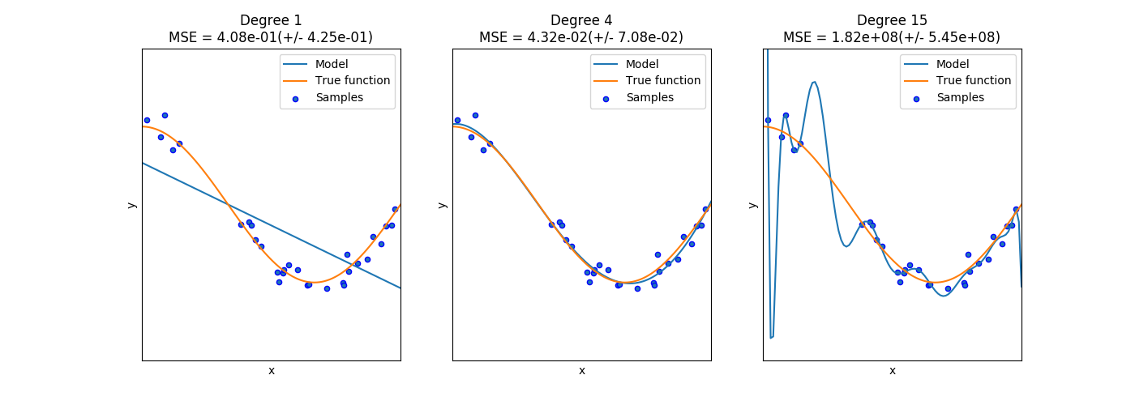
Overfitting vs underfitting
Underfitting
Overfitting
High bias, low variance
Low bias, high variance
Increase # of features or complexity of model
Get more training data, or reduce # of features or complexity of model

Slide 10
Evaluation on “LARGE” data
If many (thousands) of examples are available, then how can we evaluate our model?
A simple evaluation is sufficient
Randomly split data into training and test sets (e.g. 2/3 for train, 1/3 for test)
For classification, make sure training and testing have similar distribution of class labels
Build a model using the train set and evaluate it using the test set.

Slide 11
Model Evaluation Step 1: Split data into train and test sets
THE PAST
Results Known
0
Training set
3
2
5
Data
1
Testing set

Slide 12
Model Evaluation Step 2: Build a model on a training set
THE PAST
Results Known
0
Training set
3
2
5
Data
1
Model Builder
Testing set

Slide 13
Model Evaluation Step 3: Evaluate on test set
Results Known
0
Training set
3
2
5
Data
1
Model Builder
Evaluate
Predictions
3
4
1
2
Y
N
Testing set

Slide 14
A note on parameter tuning
It is important that the test data is not used in any way to build the model
Some learning schemes operate in two stages:
Stage 1: builds the basic structure
Stage 2: optimizes parameter settings
The test data can’t be used for parameter tuning!
Proper procedure uses three sets: training data, validation data, and test data
Validation data is used to optimize parameters

Slide 15
Model Evaluation: Train, Validation, Test split
Results Known
0
Model
Builder
3
Training set
2
5
Data
1
Evaluate
Model Builder
Predictions
1
3
0
2
Y
N
Validation set
2
3
1
0
Final Evaluation
Final Test Set
Final Model

Slide 16
Evaluation on “small” data, 1
The holdout method reserves a certain amount for testing and uses the remainder for training
Usually: one third for testing, the rest for training
For “unbalanced” datasets, samples might not be representative
Few or none instances of some classes
Stratified sample: advanced version of balancing the data
Make sure that each class is represented with approximately equal proportions in both subsets

Slide 17
Evaluation on “small” data, 2
What if we have a small data set?
The chosen 2/3 for training may not be representative.
The chosen 1/3 for testing may not be representative.

Slide 18
Repeated holdout method, 1
Holdout estimate can be made more reliable by repeating the process with different subsamples
In each iteration, a certain proportion is randomly selected for training (possibly with stratification)
The error rates on the different iterations are averaged to yield an overall error rate
This is called the repeated holdout method

Slide 19
Repeated holdout method, 2
Still not optimum: the different test sets overlap.
Can we prevent overlapping?

Slide 20
Cross-validation
Cross-validation more useful in small datasets
First step: data is split into k subsets of equal size
Second step: each subset in turn is used for testing and the remainder for training
This is called k-fold cross-validation
For classification, often the subsets are stratified before the cross-validation is performed
The error estimates are averaged to yield an overall error estimate

Slide 21
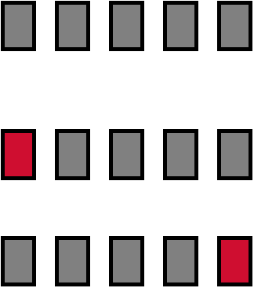
Cross-validation example:
Break up data into groups of the same size
Hold aside one group for testing and use the rest to build model
Repeat
Test
21

Slide 22
More on cross-validation
Standard method for evaluation: stratified ten-fold cross-validation
Why ten? Extensive experiments have shown that this is the best choice to get an accurate estimate
Stratification reduces the estimate’s variance
Even better: repeated stratified cross-validation
E.g. ten-fold cross-validation is repeated ten times and results are averaged (reduces the variance)
witten & eibe

Slide 23
Leave-One-Out cross-validation
Leave-One-Out: a particular form of cross-validation:
Set number of folds to number of training instances
I.e., for n training instances, build classifier n times
Makes best use of the data
Involves no random subsampling
Very computationally expensive
(exception: NN)
Hard to estimate confidence interval

Slide 24
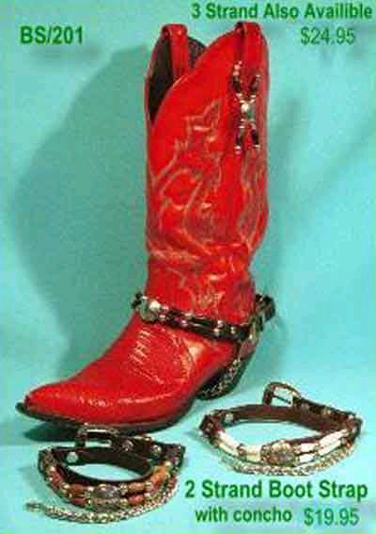
*The bootstrap
CV uses sampling without replacement
The same instance, once selected, can not be selected again for a particular training/test set
The bootstrap uses sampling with replacement to form the training set
Sample a dataset of n instances n times with replacement to form a new dataset of n instances
Use this data as the training set
Use the instances from the original dataset that don’t occur in the new training set for testing

Slide 25
*The 0.632 bootstrap
Also called the 0.632 bootstrap
A particular instance has a probability of 1–1/n of not being picked
Thus its probability of ending up in the test data is:
This means the training data will contain approximately 63.2% of the instances

Slide 26
*Estimating error with the bootstrap
The error estimate on the test data will be very pessimistic
Trained on just ~63% of the instances
Therefore, combine it with the resubstitution error:
The resubstitution error gets less weight than the error on the test data
Repeat process several times with different replacement samples; average the results
Good on very small datasets

Slide 27
Next: performance metric

Slide 28
Outline
Different cost measures
Lift charts
ROC
Evaluation for numeric predictions

Slide 29
Confusion matrix
The confusion matrix (easily generalize to multi-class)
Machine Learning methods usually minimize FP+FN
TPR (True Positive Rate): TP / (TP + FN)
FPR (False Positive Rate): FP / (TN + FP)
 |  | Predicted class
 |  | Yes | No
Actual class | Yes | TP: True positive | FN: False negative
 | No | FP: False positive | TN: True negative

Slide 30
Different Costs
In practice, different types of classification errors often incur different costs
Examples:
Terrorist profiling
“Not a terrorist” correct 99.99% of the time
Medical diagnostic tests: does X have leukemia?
Loan decisions: approve mortgage for X?
Web mining: will X click on this link?
Promotional mailing: will X buy the product?
…

Slide 31
Classification with costs
Confusion matrix 1
Confusion matrix 2
 | P | N
P | 20 | 10
N | 30 | 90
 | P | N
P | 10 | 20
N | 15 | 105
FN
Actual
Actual
FP
Predicted
Predicted
Cost matrix
Error rate: 40/150
Cost: 30x1+10x2=50
Error rate: 35/150
Cost: 15x1+20x2=55
 | P | N
P | 0 | 2
N | 1 | 0

Slide 32
Cost-sensitive classification
Can take costs into account when making predictions
Basic idea: only predict high-cost class when very confident about prediction
Given: predicted class probabilities
Normally we just predict the most likely class
Here, we should make the prediction that minimizes the expected cost
Expected cost: dot product of vector of class probabilities and appropriate column in cost matrix
Choose column (class) that minimizes expected cost

Slide 33
Example
Class probability vector: [0.4, 0.6]
Normally would predict class 2 (negative)
[0.4, 0.6] * [0, 2; 1, 0] = [0.6, 0.8]
The expected cost of predicting P is 0.6
The expected cost of predicting N is 0.8
Therefore predict P

Slide 34
Cost-sensitive learning
Most learning schemes minimize total error rate
Costs were not considered at training time
They generate the same classifier no matter what costs are assigned to the different classes
Example: standard decision tree learner
Simple methods for cost-sensitive learning:
Re-sampling of instances according to costs
Weighting of instances according to costs
Some schemes are inherently cost-sensitive, e.g. naïve Bayes

Slide 35
Lift charts
In practice, costs are rarely known
Decisions are usually made by comparing possible scenarios
Example: promotional mailout to 1,000,000 households
Mail to all; 0.1% respond (1000)
Data mining tool identifies subset of 100,000 most promising, 0.4% of these respond (400)
40% of responses for 10% of cost may pay off
Identify subset of 400,000 most promising, 0.2% respond (800)
A lift chart allows a visual comparison

Slide 36
Generating a lift chart
Use a model to assign score (probability) to each instance
Sort instances by decreasing score
Expect more targets (hits) near the top of the list
No | Prob | Target | CustID | Age
1 | 0.97 | Y | 1746 | …
2 | 0.95 | N | 1024 | …
3 | 0.94 | Y | 2478 | …
4 | 0.93 | Y | 3820 | …
5 | 0.92 | N | 4897 | …
… | … |  | … | …
99 | 0.11 | N | 2734 | …
100 | 0.06 | N | 2422
3 hits in top 5% of the list
If there 15 targets overall, then top 5 has 3/15=20% of targets

Slide 37
A hypothetical lift chart
X axis is sample size: (TP+FP) / N
Y axis is TP
80% of responses for 40% of cost
Lift factor = 2
Model
40% of responses for 10% of cost
Lift factor = 4
Random

Slide 38
Lift factor
P -- percent of the list

Slide 39
Decision making with lift charts – an example
Mailing cost: $0.5
Profit of each response: $1000
Option 1: mail to all
Cost = 1,000,000 * 0.5 = $500,000
Profit = 1000 * 1000 = $1,000,000 (net = $500,000)
Option 2: mail to top 10%
Cost = $50,000
Profit = $400,000 (net = $350,000)
Option 3: mail to top 40%
Cost = $200,000
Profit = $800,000 (net = $600,000)
With higher mailing cost, may prefer option 2

Slide 40
ROC curves
ROC curves are similar to lift charts
Stands for “receiver operating characteristic”
Used in signal detection to show tradeoff between hit rate and false alarm rate over noisy channel
Differences from gains chart:
y axis shows true positive rate in sample rather than absolute number : TPR vs TP
x axis shows percentage of false positives in sample rather than sample size: FPR vs (TP+FP)/N
witten & eibe

Slide 41
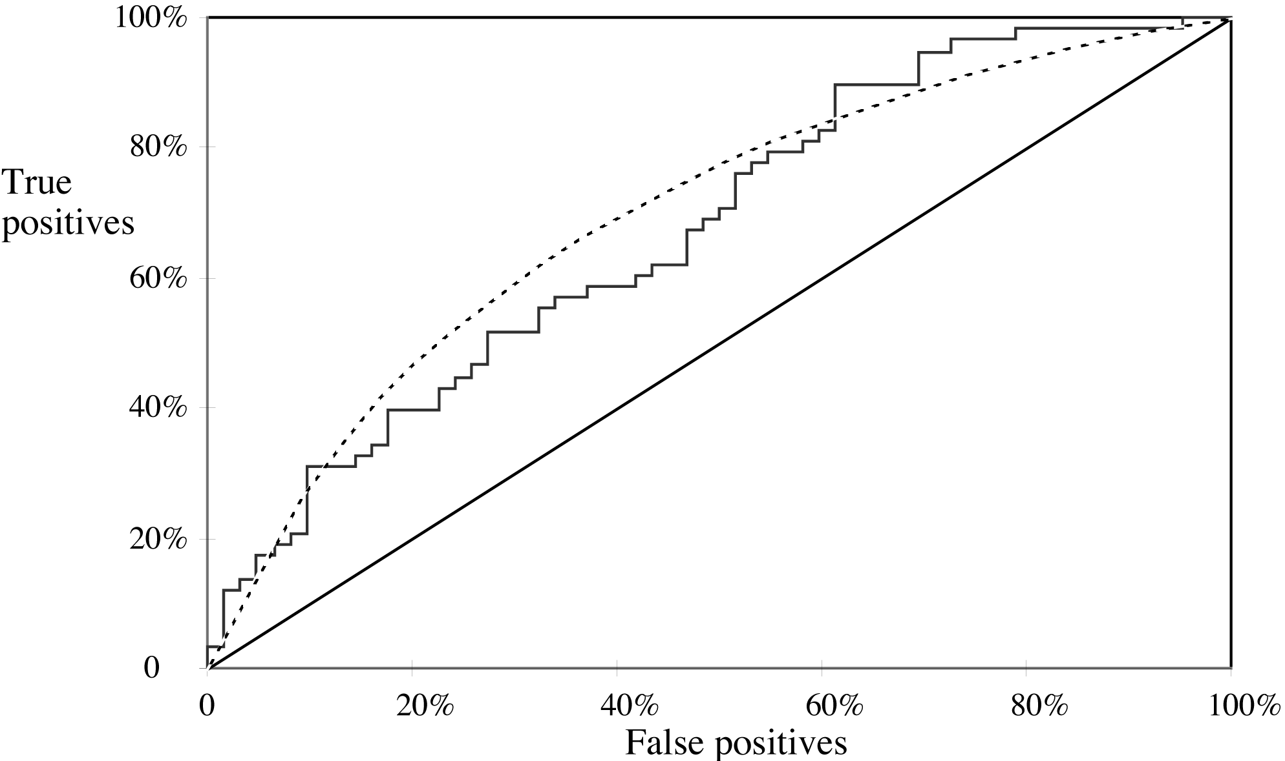
A sample ROC curve
TPR
FPR
Jagged curve—one set of test data
Smooth curve—use cross-validation
witten & eibe

Slide 42
Cross-validation and ROC curves
Simple method of getting a ROC curve using cross-validation:
Collect probabilities for instances in test folds
Sort instances according to probabilities
This method is implemented in WEKA
However, this is just one possibility
The method described in the book generates an ROC curve for each fold and averages them
witten & eibe

Slide 43
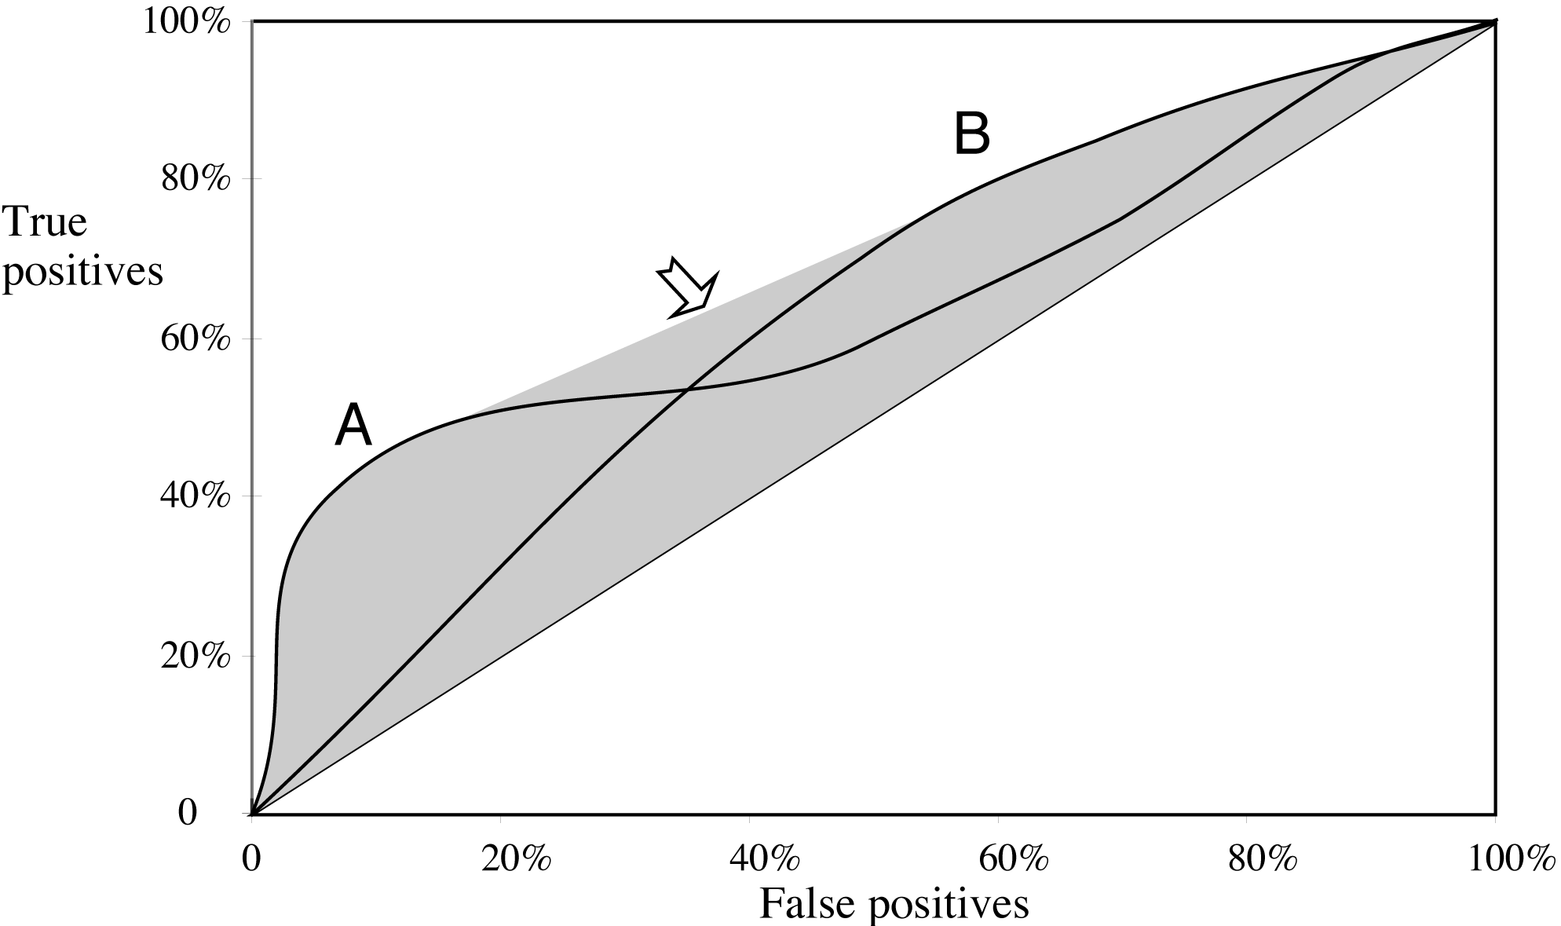
*ROC curves for two schemes
For a small, focused sample, use method A
For a larger one, use method B
In between, choose between A and B with appropriate probabilities

Slide 44
*The convex hull
Given two learning schemes we can achieve any point on the convex hull!
TP and FP rates for scheme 1: t₁ and f₁
TP and FP rates for scheme 2: t₂ and f₂
If scheme 1 is used to predict 100×q % of the cases and scheme 2 for the rest, then
TP rate for combined scheme: q × t₁+(1-q) × t₂
FP rate for combined scheme: q × f₂+(1-q) × f₂
witten & eibe

Slide 45
More measures
Percentage of retrieved documents that are relevant: precision=TP/(TP+FP)
Percentage of relevant documents that are returned: recall =TP/(TP+FN) = TPR
F-measure=(2×recall×precision)/(recall+precision)
Summary measures: average precision at 20%, 50% and 80% recall (three-point average recall)
Sensitivity: TP / (TP + FN) = recall = TPR
Specificity: TN / (FP + TN) = 1 – FPR
AUC (Area Under the ROC Curve)
witten & eibe

Slide 46
Summary of measures
 | Domain | Plot | Explanation
Lift chart | Marketing | TP Sample size | TP (TP+FP)/(TP+FP+TN+FN)
ROC curve | Communications | TP rate FP rate | TP/(TP+FN) FP/(FP+TN)
Recall-precision curve | Information retrieval | Recall Precision | TP/(TP+FN) TP/(TP+FP)

Slide 47
Aside: the Kappa statistic
Two confusion matrix for a 3-class problem: real model (left) vs random model (right)
Number of successes: sum of values in diagonal (D)
Kappa = (D_{real} – D_{random}) / (D_{perfect} – D_{random})
(140 – 82) / (200 – 82) = 0.492
Accuracy = 0.70
Predicted
Predicted
 | a | b | c
a | 88 | 10 | 2 | 100
b | 14 | 40 | 6 | 60
c | 18 | 10 | 12 | 40
 | 120 | 60 | 20 | 200
 | a | b | c
a | 60 | 30 | 10 | 100
b | 36 | 18 | 6 | 60
c | 24 | 12 | 4 | 40
 | 120 | 60 | 20 | 200
total
total
Actual
Actual
total
total

Slide 48
The Kappa statistic (cont’d)
Kappa measures relative improvement over random prediction
(D_{real} – D_{random}) / (D_{perfect} – D_{random})
= (D_{real} / D_{perfect} – D_{random} / D_{perfect} ) / (1 – D_{random} / D_{perfect} )
= (A-C) / (1-C)
D_{real} / D_{perfect} = A (accuracy of the real model)
D_{random} / D_{perfect}= C (accuracy of a random model)
Kappa = 1 when A = 1
Kappa ≈ 0 if prediction is no better than random guessing

Slide 49
The kappa statistic – how to calculate D_{random} ?
Expected confusion matrix, E, for a random model
Actual confusion matrix, C
 | a | b | c
a | 88 | 10 | 2 | 100
b | 14 | 40 | 6 | 60
c | 18 | 10 | 12 | 40
 | 120 | 60 | 20 | 200
 | a | b | c
a | ? |  |  | 100
b |  |  |  | 60
c |  |  |  | 40
 | 120 | 60 | 20 | 200
total
total
Actual
Actual
total
total
E_{ij} = ∑_{k}C_{ik} ∑_{k}C_{kj} / ∑_{ij}C_{ij}
100*120/200 = 60
Rationale: 0.5 * 0.6 * 200

Slide 50
Evaluating numeric prediction
Same strategies: independent test set, cross-validation, significance tests, etc.
Difference: error measures
Actual target values: a₁ a₂ …a_{n}
Predicted target values: p₁ p₂ … p_{n}
Most popular measure: mean-squared error
Easy to manipulate mathematically

Slide 51
Other measures
The root mean-squared error :
The mean absolute error is less sensitive to outliers than the mean-squared error:
Sometimes relative error values are more appropriate (e.g. 10% for an error of 50 when predicting 500)

Slide 52
Improvement on the mean
How much does the scheme improve on simply predicting the average?
The relative squared error is ( is the average):
The relative absolute error is:
= r²
witten & eibe

Slide 53
Correlation coefficient
Measures the statistical correlation between the predicted values and the actual values
Scale independent, between –1 and +1
Good performance leads to large values!
Equivalent to r² when

Slide 54
Which measure?
Best to look at all of them
Often it doesn’t matter
Example:
 | A | B | C | D
Root mean-squared error | 67.8 | 91.7 | 63.3 | 57.4
Mean absolute error | 41.3 | 38.5 | 33.4 | 29.2
Root rel squared error | 42.2% | 57.2% | 39.4% | 35.8%
Relative absolute error | 43.1% | 40.1% | 34.8% | 30.4%
Correlation coefficient | 0.88 | 0.88 | 0.89 | 0.91
D best
C second-best
A, B arguable

Slide 55
Evaluation Summary:
Avoid Overfitting
Use Cross-validation for small data
Don’t use test data for parameter tuning - use separate validation data
Consider costs when appropriate

Slide 56
Cross-validation and perf eval in sklearn
def confusionMatrix(actual, pred):
classes = np.unique([actual, pred])
cm = [[sum((actual == i) & (pred == j))
for i in classes]
for j in classes]
cm = pd.DataFrame(cm, index=classes, columns=classes)
cm.index.name='actual'
cm.columns.name='pred'
return cm
Predicting paid account
In [1220]: import sklearn.linear_model as lm
...: lr = lm.LogisticRegression()
...: lr.fit(x, y)
...: pred_prob=lr.predict_proba(x)
...: confusionMatrix(y, pred_prob[:,1] >= 0.5)
...:
Out[1220]:
pred 0 1
actual
0 144 24
1 4 28
In [1222]: import sklearn.model_selection as ms
...: pred_prob=ms.cross_val_predict(lr, x, y, method='predict_proba')
...: confusionMatrix(y, pred_prob[:,1] >= 0.5)
Out[1222]:
pred 0 1
actual
0 144 25
1 4 27
In [1273]: metrics.accuracy_score(y, pred_prob[:,1]>=0.5)
Out[1273]: 0.85999999999999999
In [1271]: metrics.cohen_kappa_score(y, pred_prob[:,1]>=0.5)
Out[1271]: 0.58432304038004745

Slide 57
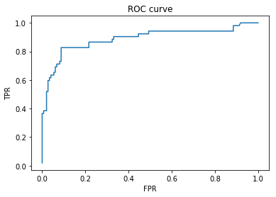
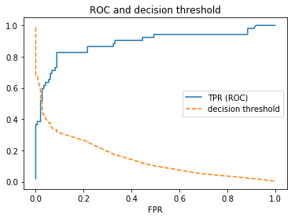
ROC function in sklearn
In [1257]: import sklearn.metrics as metrics
...: roc=metrics.roc_curve(y, pred_prob[:,1])
...: plot(roc[0], roc[1])
...: xlabel('FPR')
...: ylabel('TPR')
In [1259]: metrics.roc_auc_score(y, pred_prob[:,1])
Out[1259]: 0.88831860706860699
In [1270]: plot(roc[0], roc[1], '-', roc[0], roc[2], '--')
...: xlabel('FPR')
...: legend(['TPR (ROC)', 'decision threshold'])

